Slide 1
EE530 - FINAL PROJECT
WAVELET-BASED NOISE REMOVAL
Student: Rafael Lima
ID: 20155403

Slide 2
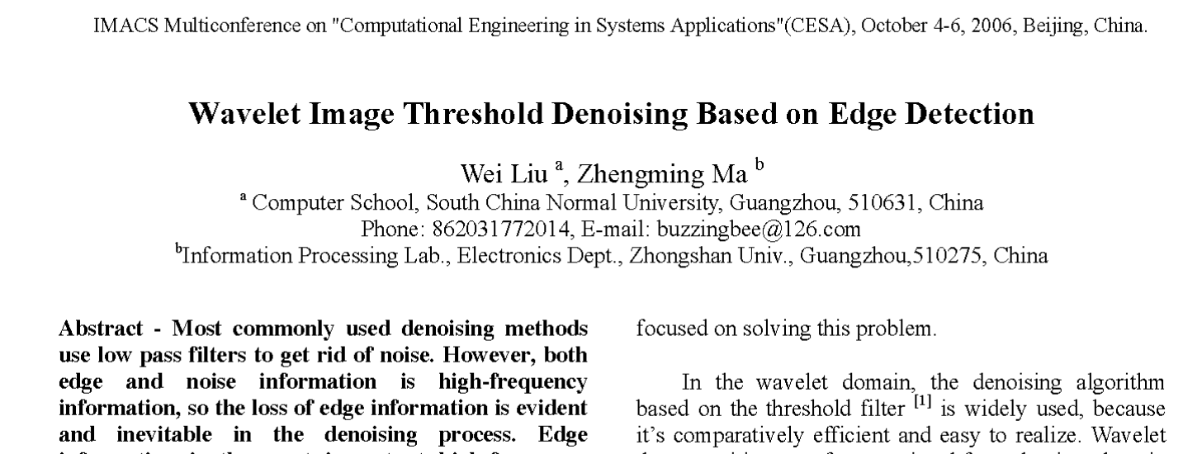
Reference Paper

Slide 3
Background
Image Denoising:
Removing noise from image (for both aesthetical and technical reasons);
Basic idea is to reduce high frequencies.

Slide 4
Problem Statement
Both noise and edges are characterized by high frequencies.
Thus, it is difficult to remove noise from images without blurring the edges.

Slide 5
Review of Existing Methods
In the wavelet domain, the denoising algorithm based on the threshold filter is widely used -> comparatively efficient and easy
Wavelet decomposition transforms a signal from the time domain to the time-scale domain -> “shifting and scaling”
Select a threshold according to the characteristics of the image, modifying the discrete detail coefficients so as to reduce the noise.
Higher Threshold = Better Denoising + Blurrier Edges (trade-off)

Slide 6
Method Proposed in the Paper
Also a wavelet threshold-based method;
But, before denoising, wavelet coefficients corresponding to an image’s edges are first detected (through Lipschitz Exponents);
Softer threshold is applied to these edges’ coefficients and harder threshold is applied to the remaining coefficients.

Slide 7
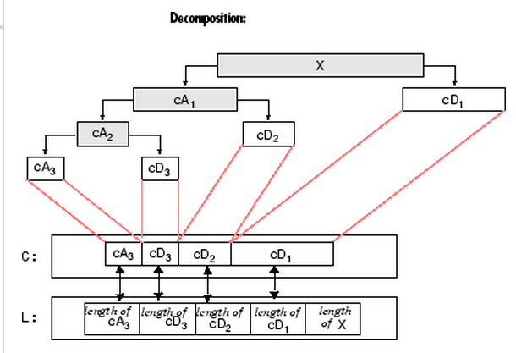
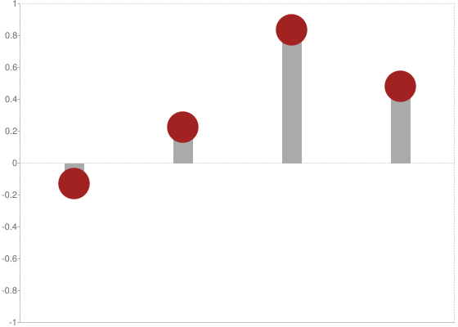
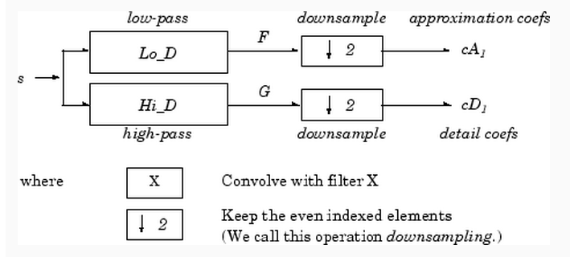
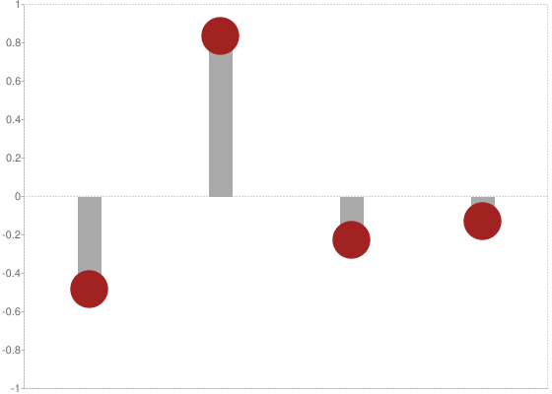
Method Proposed in the Paper
Basics of Discrete Wavelet Decomposition:
(Source: www.mathworks.com)

Slide 8
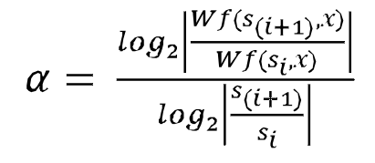
Method Proposed in the Paper
Basic Algorithm:
Detect the wavelet corresponding to the image’s edges by the method of Lipschitz Exponent (α):
(α>0: Edge; α<0: Noise)
Wf(s_{i},x): Value of the Wavelet component at coordinate “x” and decomposition level “i”
s_{i} = 2^{i}
(source: "Measurement of Lipschitz Exponent (LE)
using Wavelet Transform Modulus Maxima (WTMM)", by Venkatakrishnan et al. (IJSER - June/2012).

Slide 9
Method Proposed in the Paper
Basic Algorithm:
2. Preserve the coefficients corresponding to the edges;
3. Apply wavelet transform to the original noise-corrupted image;
4. Apply soft-threshold (T = β*σ*sqrt(lnN)) in the edge coefficients and hard-threshold (T = σ*sqrt(lnN)) in the remaining ones;
5. Recompose the image from the thresholded components.
Parameters:
0.2 < β < 0.3
σ: Strength of the noise (related to the variance)
N: Number of elements in the decomposition level

Slide 10
Why is this method better than others?
If the edge-related coefficients are precisely detected, the remaining of the image can be subject to hard-thresholding without an excessive blurring of the edges (trade-off “higher denoising + blurrier edges” can be circumvented).

Slide 11
Result with examples
The algorithm was implemented with a “Lena” 256x256 image;
A code from the Mathworks website was used for comparison with both the hard and soft-threshold Visushrink denoising algorithms;
For the comparisons: β = 0.2 and σ = 10.

Slide 12
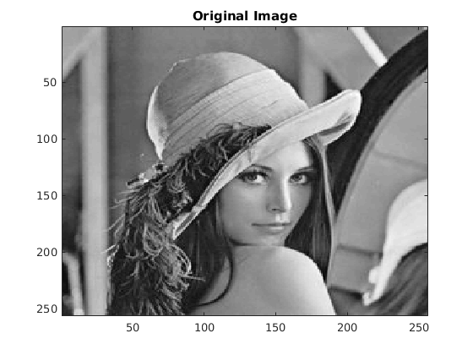

Result with examples
SNR = 22.55 (dB)

Slide 13

Result with examples
SNR = 23.07 (dB)

Slide 14
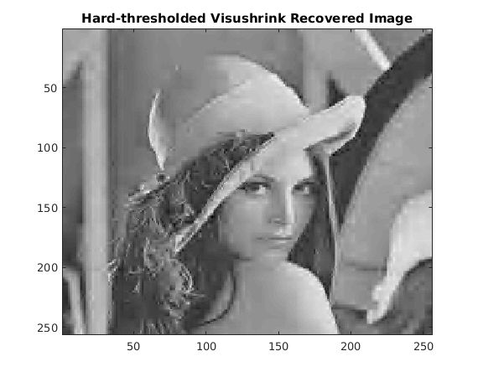
Result with examples
SNR = 22.96 (dB)

Slide 15
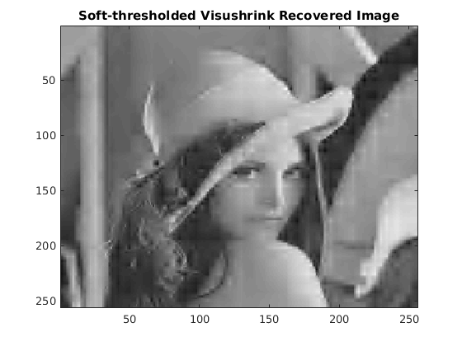
Result with examples
SNR = 20.19 (dB)

Slide 16
Conclusion
Denoising Method | None | Implemented Algorithm | Visushrink Hard-threshold | Visushrink Soft-threshold
SNR (dB) | 22.55 | 23.07 | 22.96 | 20.19

Slide 17
Proposal for possible improvement
Use a more efficient detector for extracting the edges (Average Local Distance, Sobel Mask), since computing Lipschitz exponents is extremely inneficient in both memory usage and runtime.
“Sharpen” and denoise the edge area through, perhaps, a median filter.

Slide 18
Thank You

